Slide 1

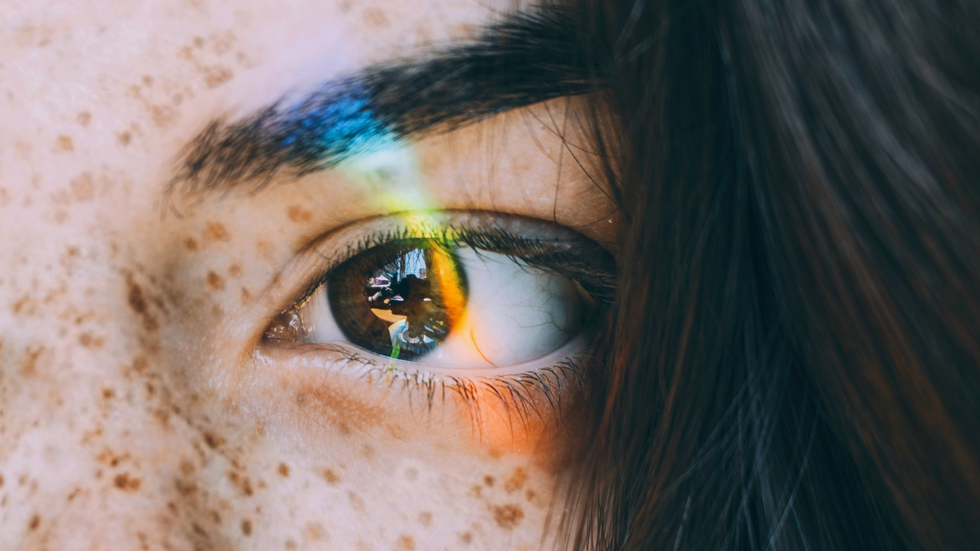



GitHub copilot -
Vision Feature

Slide 2

Copilot Vision
The GitHub Copilot Vision feature allows users to attach images and work with them directly in Copilot Chat.
You can share screenshots of errors, and Copilot will interpret the image and help resolve the issue.
Why Use Copilot Vision ?
Code Generation from Images:
Developers can use Copilot Vision to generate code based on visual inputs. For example, it can help create code for image processing tasks or generate HTML/CSS code from a screenshot of a web design.
Enhanced Documentation:
Copilot Vision can assist in creating more comprehensive documentation by including visual aids and explanations derived from images.
Image Understanding:
Copilot Vision can analyze and understand images, enabling developers to integrate visual data into their projects more effectively. This includes tasks like image classification, object detection, and image segmentation.

Slide 3
When to use vision feature?
Code Suggestions: Get suggestions for fixing bugs or refactoring code to improve readability and performance.
.Error Handling: Automatically generate error handling code and logging.
Auto-Generated Comments: Generate comments and documentation for your code, making it easier to understand and maintain.
Explaining Code: Use it to write explanations and descriptions for complex code blocks.

Slide 4
Thank You

